Slide 1




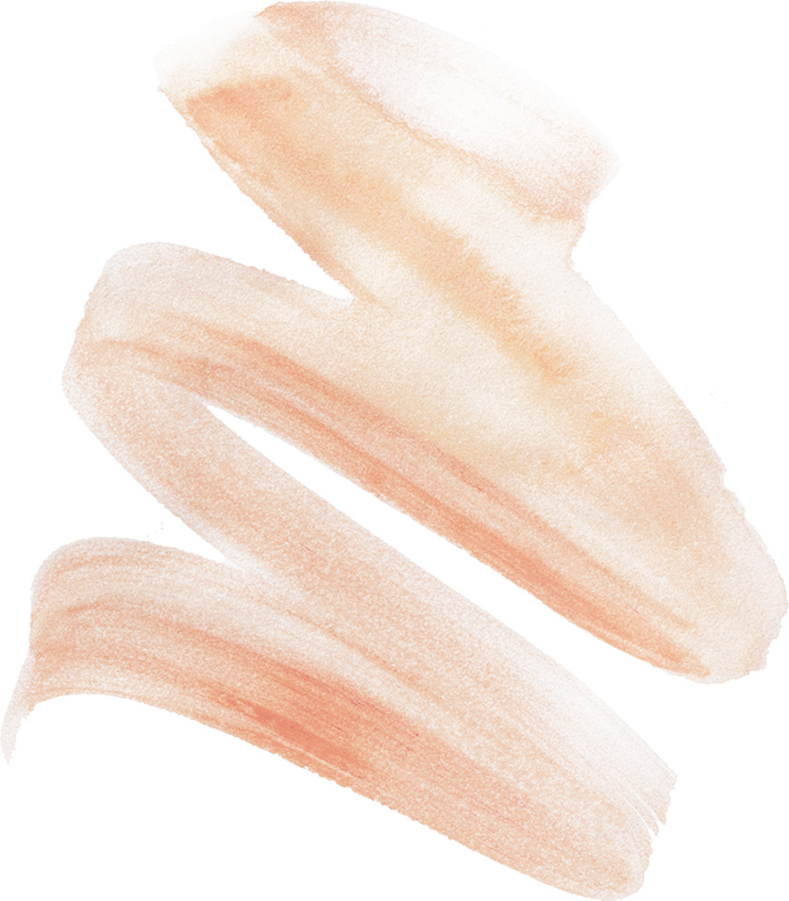


SPA RESORT
ZHUYSI
THE FINAL PROJECT BY MURZASHEVA ZHANAT AND ZHUMABAY AITMYRZA

Slide 2
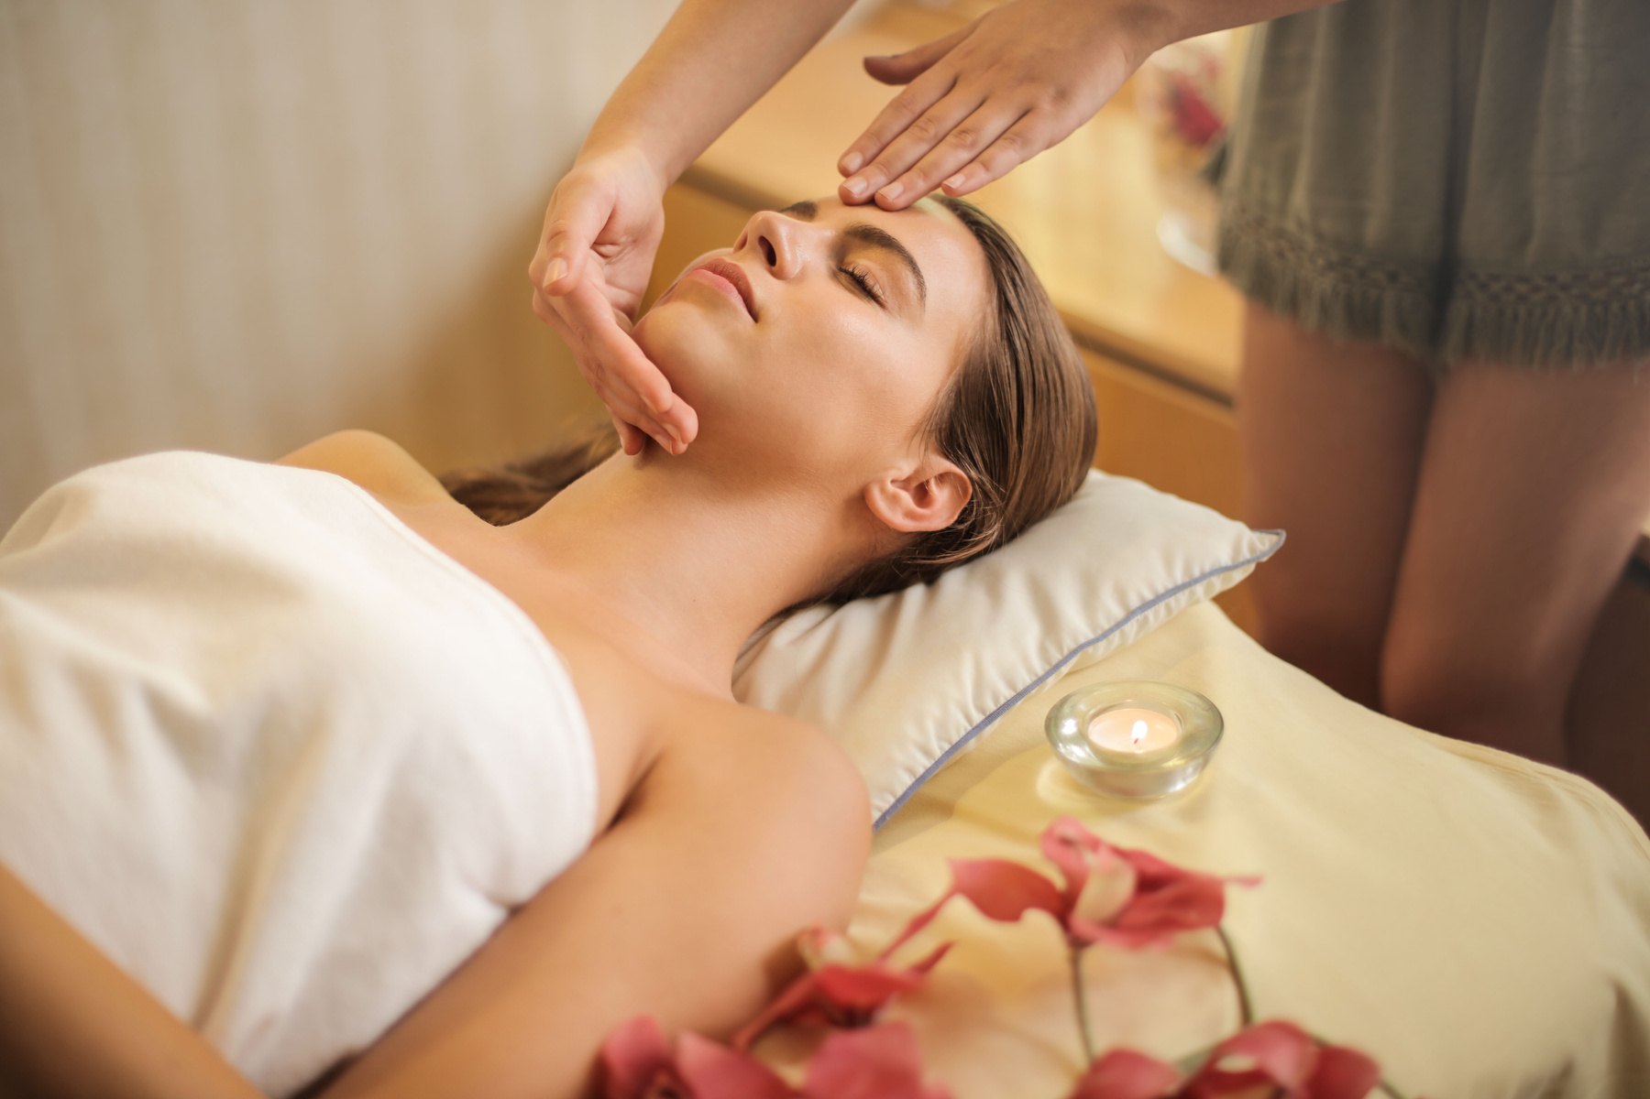
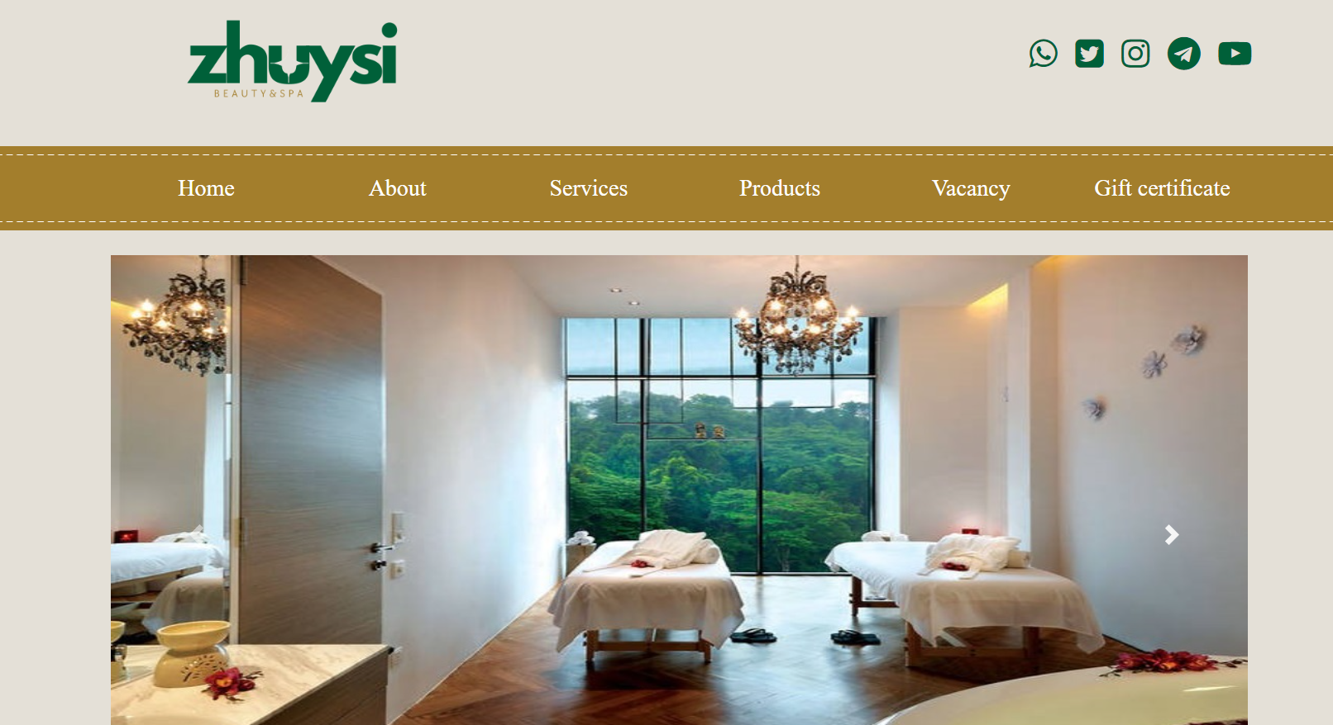
Welcome To Our
SPA Resort
OUTLINE
1.Purpose of the Project
2. Analysis of Other Websites
3. Main Features of the Website
4. Conclusion
LEARN MORE

Slide 3

1. Purpose of the Project
The primary goal of the Cosmetology and Spa Center website is
to enhance the online presence of the center
providing a seamless and informative platform for both existing and potential clients
The website aims to reflect the essence of the center's commitment to offering high-quality cosmetic and spa services that cater to the well-being of the body, mind, and soul.

Slide 4





2. Analysis of Other Websites
In conducting a thorough analysis of competitors' websites, we identified key areas for improvement and differentiation. Some common observations were outdated design, lack of user-friendly interfaces, and limited information about services. Our project aimed to address these issues and create a modern, responsive website that stands out in the competitive market.
IMBIR THAI SPA's website is visually appealing with user-friendly navigation and comprehensive content. However, the lack of an online appointment booking feature could impact user convenience and suggests room for improvement.
Lotus Thai Spa's website has design appeal but faces navigation challenges with slow loading times and limited content. The absence of interactive features may impact user engagement. Improvements are needed for a better user experience.

Slide 5
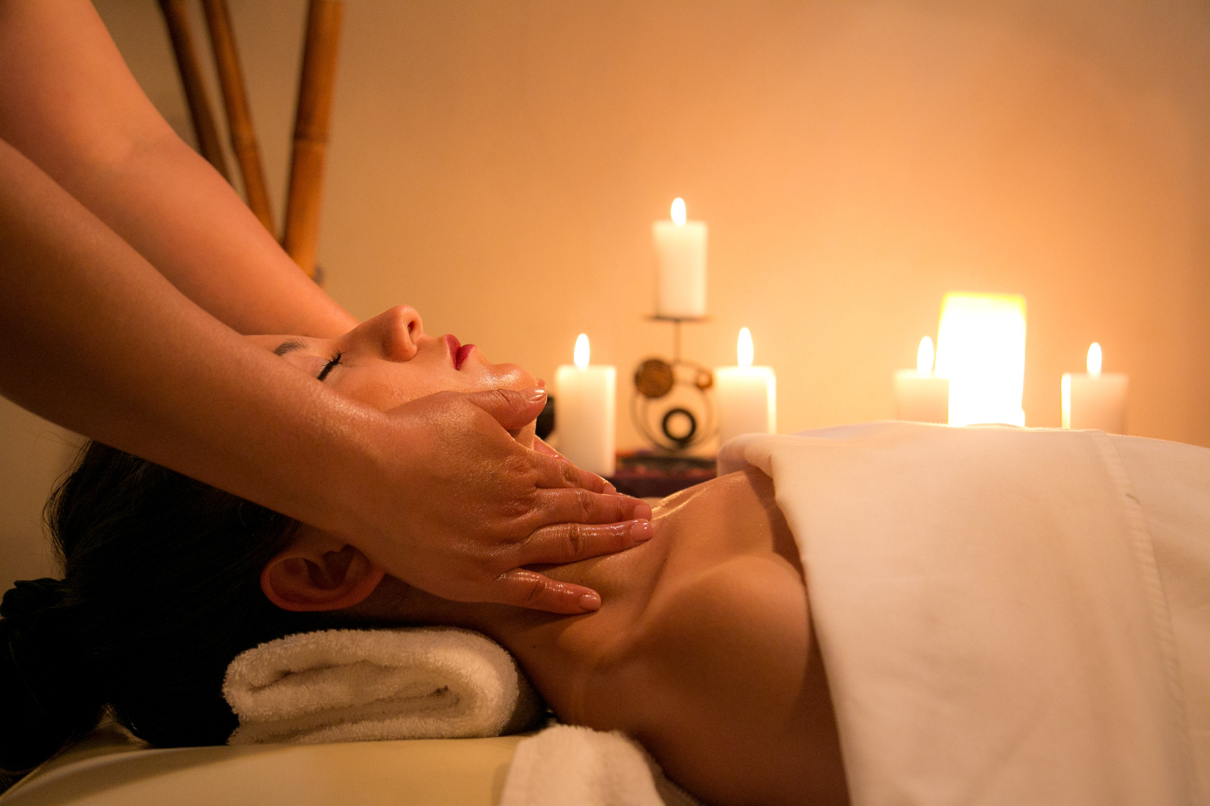

3. Main Features of the Website
Responsive Design:
User-Friendly Navigation:
Our website boasts a responsive design, ensuring an optimal viewing experience across various devices, including desktops, tablets, and smartphones. This guarantees accessibility for a broad audience.
Intuitive navigation is a priority, allowing visitors to easily explore the range of cosmetic and spa services offered by the center. Clear menus and well-organized content contribute to a seamless user experience.

Slide 6
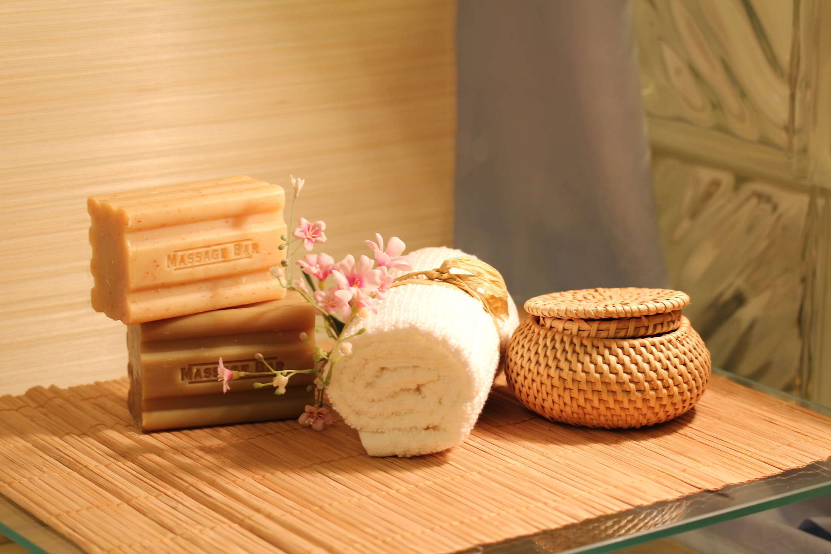

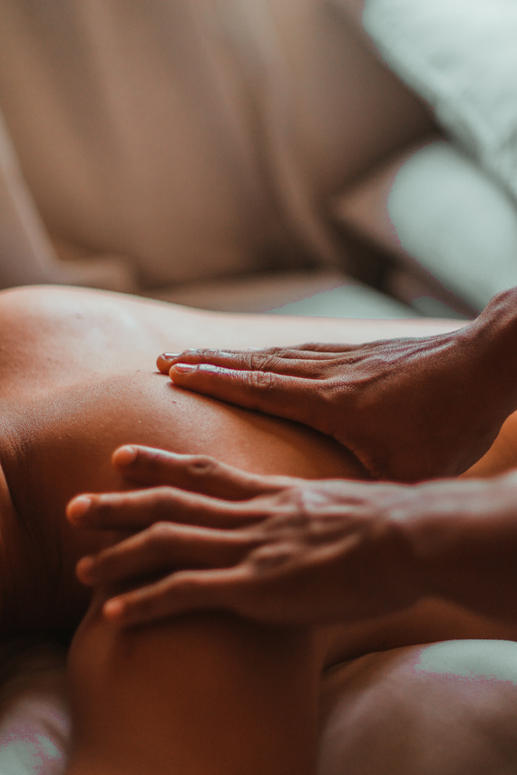

3. Main Features of the Website
Comprehensive Service Information:
Detailed information about the center's services, including cosmetic procedures, injection services, spa treatments, and product details, is provided. This transparency fosters trust and helps clients make informed decisions.
Customized Programs:
Highlighting the center's commitment to personalized care, the website showcases customized rejuvenation programs. Clients can learn about body wraps, saunas, massages, and peeling procedures tailored to their individual preferences and needs.
Staff Qualifications and Product Quality:
A dedicated section emphasizes the qualifications of the center's highly skilled staff and the use of licensed, high-quality cosmetic products and equipment.
REGISTER NOW

Slide 7
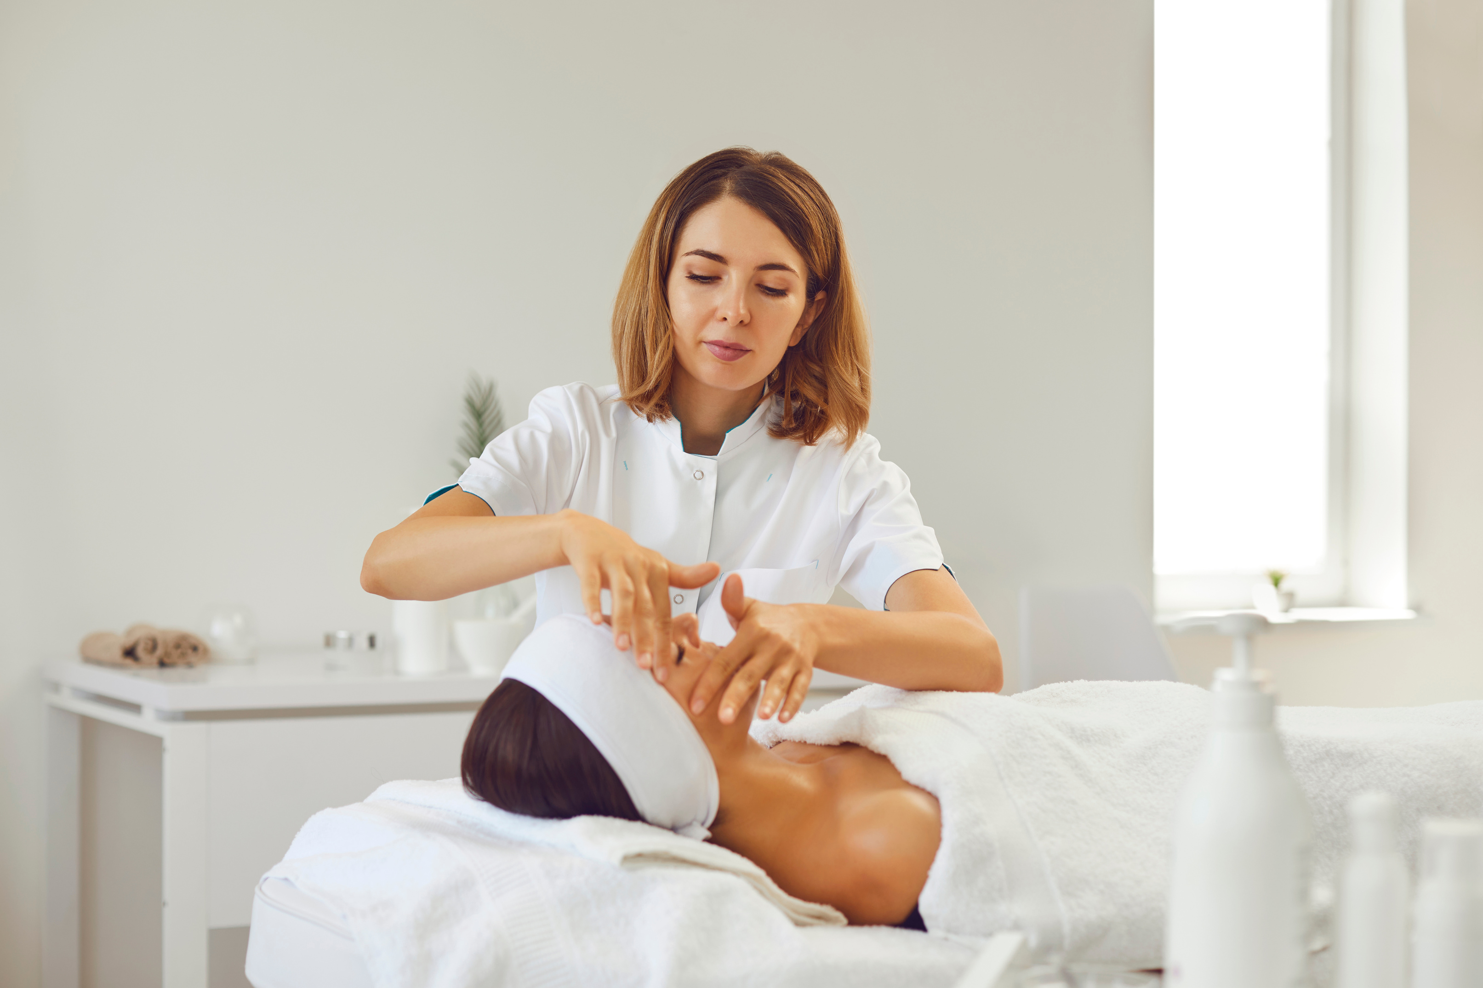

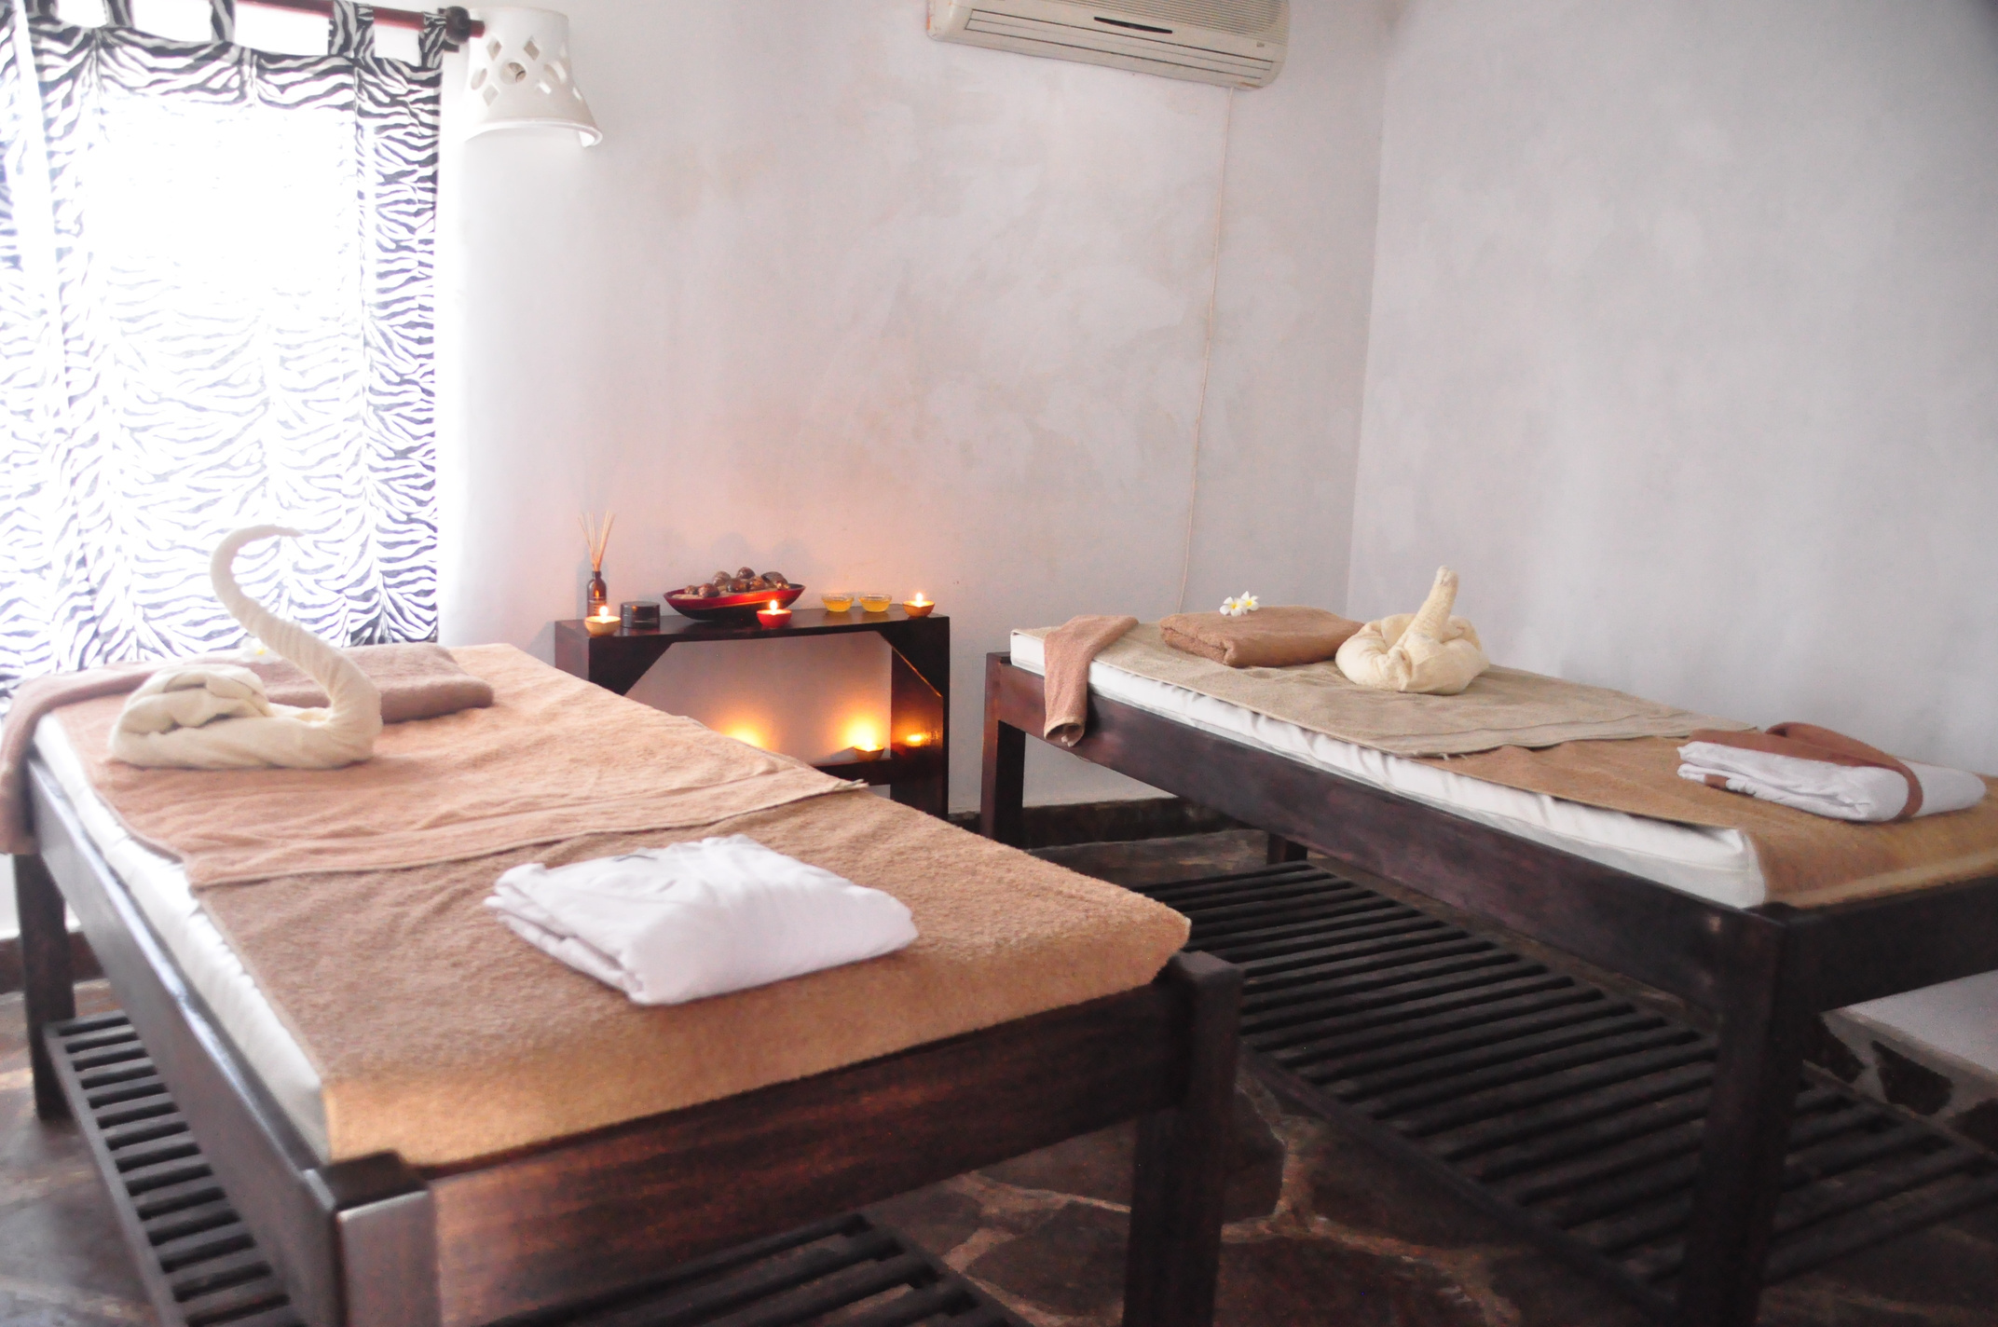
4. Conclusion
The development of the Cosmetology and Spa Center website aligns with the center's commitment to excellence. By addressing the shortcomings identified in competitor analysis, our website stands as a user-friendly, informative, and visually appealing platform. It not only serves as a virtual gateway to the center but also reinforces the dedication to enhancing the health and aesthetics of clients.
Zhanat Murzasheva
Zhumabay Aitmyrza
SE - 2225

Slide 8
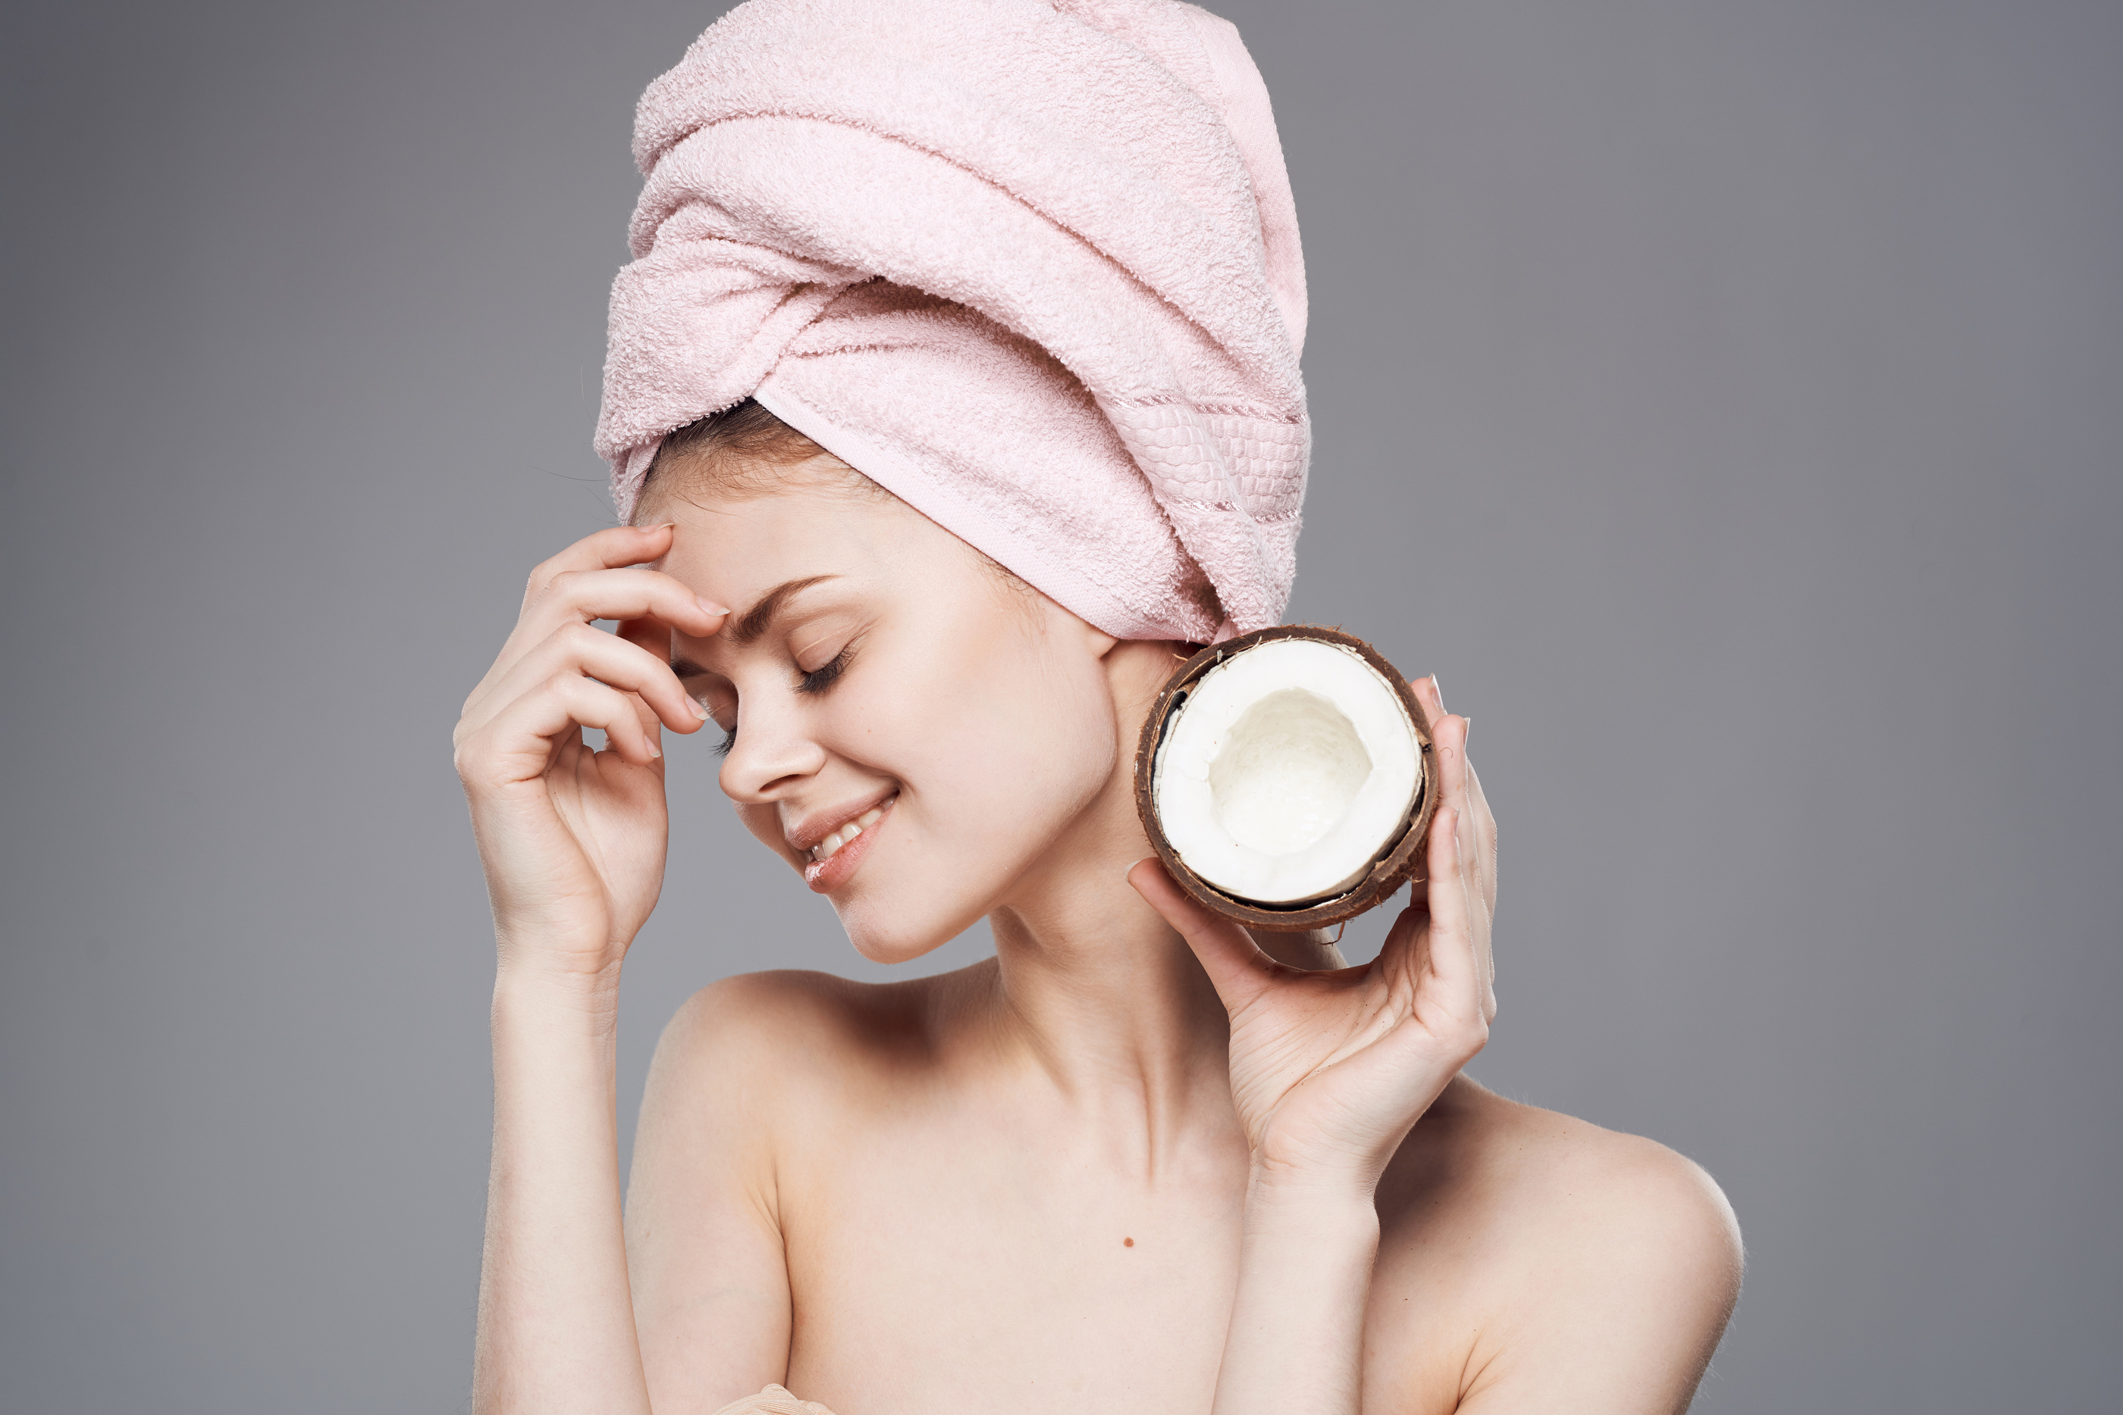
Thank You
In summary, our project has successfully translated the essence of the Cosmetology and Spa Center into a digital experience that reflects its commitment to quality, customization, and overall well-being. The website serves as a powerful tool to attract and retain clients, fostering a positive and lasting impression of the center's services.
GITHUB:https://github.com/zhuysi/WEB-FINAL.git

